Slide 1
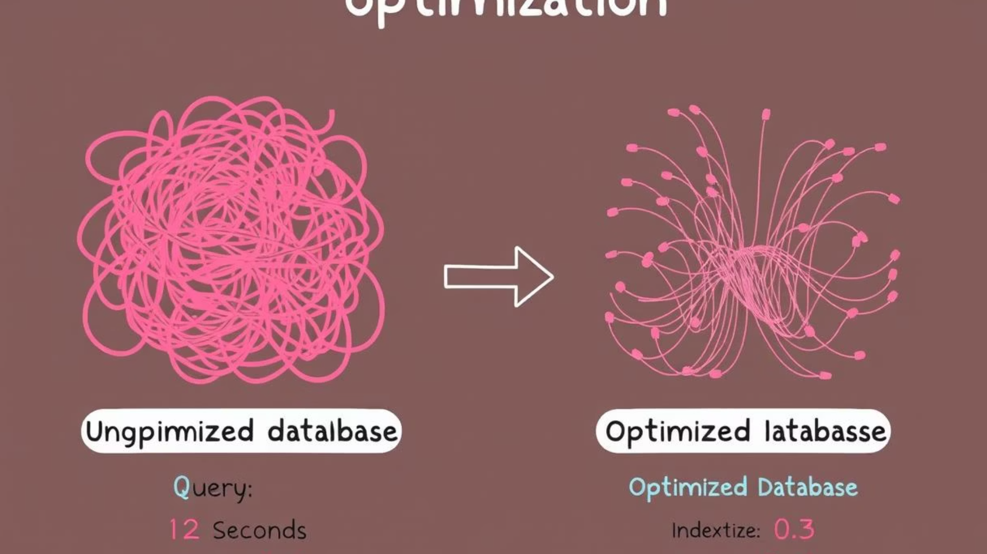

Apple Retail Sales Analysis SQL Project - Analyzing 1 Million Row Data
This project was ideal for me as an aspiring data analyst looking to enhance my SQL skills by working with a large-scale dataset and solving real-world business questions.

Slide 2
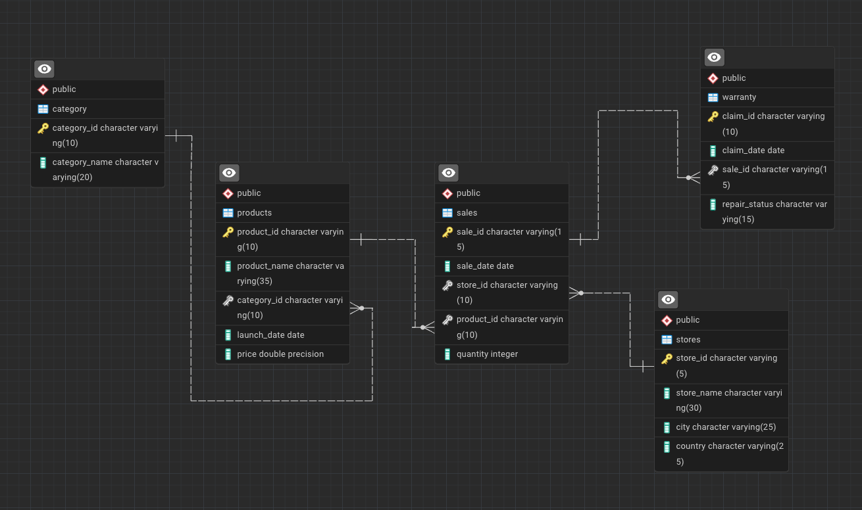
ER DIAGRAM

Slide 3
Improving Query Performance Through Indexing
Before Indexing
After Indexing
Execution Time: 117.743 ms
Execution Time: 21.867 ms
Planning Time: 0.09 ms
Planning Time: 0.111 ms
EXPLAIN ANALYSE
SELECT * FROM sales WHERE product_id='P-33
EXPLAIN ANALYSE
SELECT * FROM sales WHERE product_id='P-33'
The following indexes were created to improve query performance:
CREATE INDEX sales_product_id ON sales(product_id);
CREATE INDEX sales_sale_id ON sales(sale_id);
CREATE INDEX sales_sale_date ON sales(sale_date);
As shown in the results, indexing reduced the execution time by approximately 81%, demonstrating significant performance improvement.

Slide 4
Store Analysis Queries
Q1. Find the number of stores in each country
SELECT country, COUNT(*) AS total_stores
FROM stores
GROUP BY country;
Q2. Calculate the total number of units sold by each store
SELECT s.store_id, s.store_name, SUM(sa.quantity) AS total_units_sold
FROM stores s
JOIN sales sa ON s.store_id = sa.store_id
GROUP BY s.store_id, s.store_name;
Q6. Identify which store had the highest total units sold in the last year
SELECT s.store_id, s.store_name, SUM(sa.quantity) AS total_units_sold
FROM stores s
JOIN sales sa ON s.store_id = sa.store_id
WHERE sa.sale_date >= '2024-01-01'
GROUP BY s.store_id, s.store_name
ORDER BY total_units_sold DESC
LIMIT 1;

Slide 5
Sales Analysis Queries
Q3. Identify how many sales occurred in December 2023
SELECT COUNT(*) AS december_2023_sales
FROM sales
WHERE sale_date BETWEEN '2023-12-01' AND '2023-12-31';
Q7. Count the number of unique products sold in the last year
SELECT COUNT(DISTINCT product_id) AS unique_products_sold
FROM sales
WHERE sale_date >= '2024-01-01';
Q10. For each store, identify the best-selling day based on highest quantity sold
SELECT * FROM
(SELECT
store_id,TO_CHAR(sale_date, 'Day') as day_name,
SUM(quantity) as total_unit_sold,
RANK() OVER(PARTITION BY store_id ORDER BY SUM (quantity) DESC) as rank
FROM sales
GROUP BY 1, 2
)as t1
WHERE rank = 1

Slide 6
Product and Category Analysis
Q8. Find the average price of products in each category
SELECT p.category_id,
c.category_name,AVG(p.price) AS avg_price
FROM products as p JOIN category c
ON p.category_id=c.category_id
GROUP BY 1,2
ORDER BY 3 DESC;
Q14. Identify the product category with the most warranty claims filed in the last two years
SELECT c.category_name, COUNT(*) AS total_claims
FROM warranty w
JOIN sales s ON w.sale_id = s.sale_id
JOIN products p ON s.product_id = p.product_id
JOIN category c ON p.category_id = c.category_id
WHERE w.claim_date >= CURRENT_DATE - INTERVAL '2 years'
GROUP BY c.category_name
ORDER BY total_claims DESC
LIMIT 1;

Slide 7
Warranty Claims Analysis
Claim Frequency
Claim Status
Product Correlation
Analyze how often warranty claims are filed across different time periods
Examine the percentage of claims that are approved, rejected, or pending
Identify which products and categories generate the most warranty claims
Q4. Determine how many stores have never had a warranty claim filed
SELECT COUNT (DISTINCT s.store_id) AS stores_without_warranty_claims
FROM stores s
LEFT JOIN sales sa ON s.store_id = sa.store_id
LEFT JOIN warranty w ON sa.sale_id = w.sale_id
WHERE w.sale_id IS NULL;
Q5. Calculate the percentage of warranty claims marked as "Rejected"
SELECT ROUND((SELECT COUNT(*)
FROM warranty
WHERE repair_status = 'Rejected') * 100.0/(SELECT COUNT(*) FROM warranty), 2) AS Rejected_percentage;

Slide 8
Time-Based Warranty Analysis
Q9. How many warranty claims were filed in 2020?
SELECT COUNT(*) AS warranty_claims_2020
FROM warranty
WHERE claim_date BETWEEN '2020-01-01' AND '2020-12-31';
Q11. Calculate how many warranty claims were filed within 180 days of a product sale
SELECT COUNT (*) AS claims_within_180_days
FROM warranty w
JOIN sales s ON w.sale_id = s.sale_id
WHERE w.claim_date <= s.sale_date + INTERVAL '180 days';
Q12. Determine how many warranty claims were filed for products launched in the last two years
SELECT COUNT (*) AS claims_for_recent_products
FROM warranty w
JOIN sales s ON w.sale_id = s.sale_id
JOIN products p ON s.product_id = p.product_id
WHERE p.launch_date >= CURRENT_DATE - INTERVAL '2 years';

Slide 9
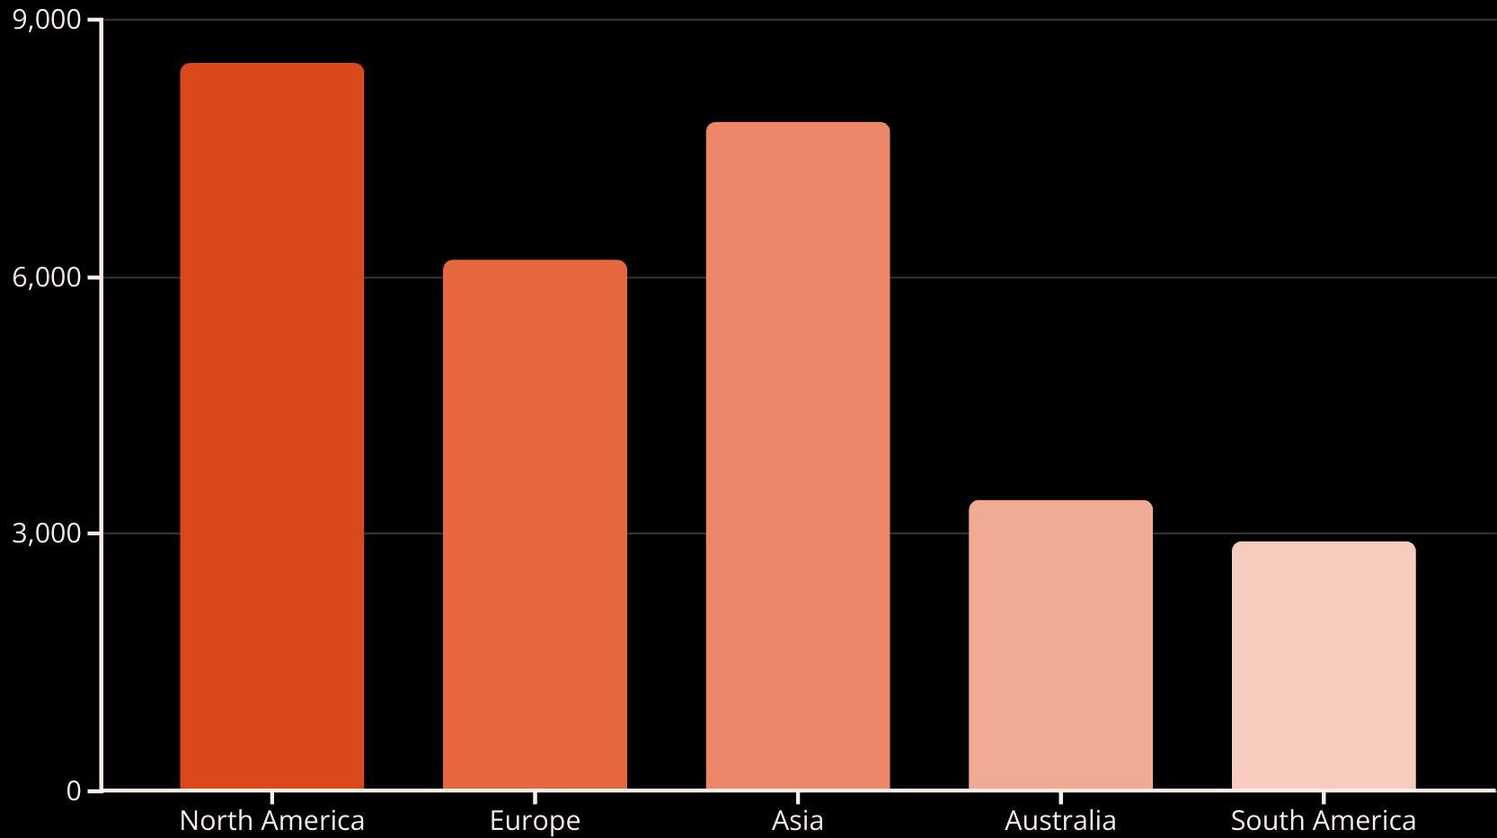
Regional Sales Performance
Q13. List the months in the last three years where sales exceeded 5,000 units in the USA
SELECT TO_CHAR (s.sale_date, 'YYYY-MM') AS sale_month, SUM(s.quantity) AS total_units
FROM sales s
JOIN stores st ON s.store_id = st.store_id
WHERE st.country = 'USA'
AND s.sale_date >= CURRENT_DATE - INTERVAL '3 years'
GROUP BY sale_month
HAVING SUM(s.quantity) > 5000;

Slide 10
Product Performance by Region
Q15. Identify the least selling product in each country for each year based on total units sold
WITH ProductSales AS (
SELECT
st.country,
EXTRACT(YEAR FROM s.sale_date) AS sale_year,
s.product_id,
SUM(s.quantity) AS total_units
FROM sales s
JOIN stores st ON s.store_id = st.store_id
GROUP BY st.country, sale_year, s.product_id
),RankedProducts AS (
SELECT
country,
sale_year,
product_id,
total_units,
RANK() OVER (PARTITION BY country, sale_year ORDER BY total_units ASC) AS rank
FROM ProductSales
)
SELECT country, sale_year, product_id, total_units
FROM RankedProducts
WHERE rank = 1;

Slide 11




Query Performance Best Practices
Create Appropriate Indexes
Add indexes on frequently queried columns to improve search performance
Optimize Query Structure
Use EXPLAIN ANALYZE to identify and resolve performance bottlenecks
Regular Maintenance
Perform routine database maintenance to ensure optimal performance
Monitor Query Execution
Track execution times and implement improvements where needed
As demonstrated in the first section, proper indexing can dramatically improve query performance. The execution time for our sample query was reduced from 117.743 ms to 21.867 ms after implementing appropriate indexes on the sales table. This represents an 81% improvement in query performance, highlighting the importance of database optimization techniques in business intelligence applications.

Slide 12
THANK YOU
If you're hiring or know someone who is - Let's connect!

